Slide 1

Persona Investor
John Banks is an investor looking to invest in ecommerce markets outside the USA. His aim is to determine which sellers are the best ones too invest with. He is 37 years old, Married, with two kids. He is extremely picky as his livelihood is dependant on making the best investments.

Slide 2
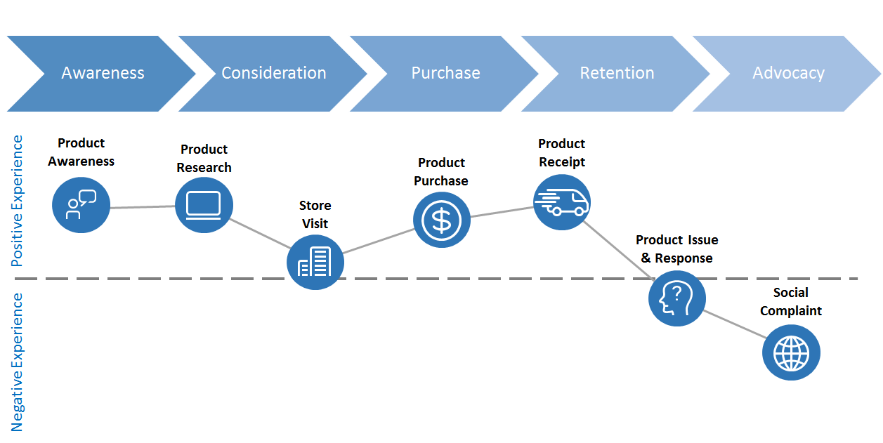
Journey Map Investor
Needs to select the best sellers too invest with
Considers reviews, orders, customers, payments and other variables
Determine what factors contributes to seller success
Try to predict which seller will do best in the next few years
Invest

Slide 3
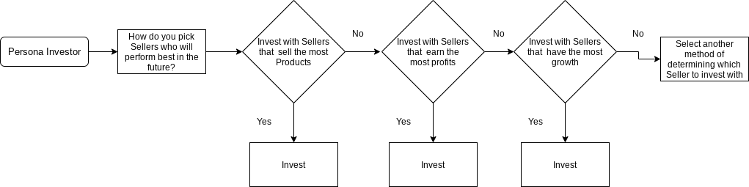

Slide 4

Persona Seller
Eli Rogers is a trying to become a profitable seller. She is looking too determine which products sell the best for each of her future competitors. She is trying to determine what are the most profitable items sold. So that she knows what items too begin selling. Allowing her to invest her time competing only for the most profitable items. She is a 23 years old Single women. She is hard working but lacks experience.

Slide 5
Journey Map Seller
Needs to select the most profitable items to sell
Considers reviews, orders, customers, payments and other variables
Determine what factors contributes to making an item profitable
Determine which items are most profitable
Start Selling

Slide 6
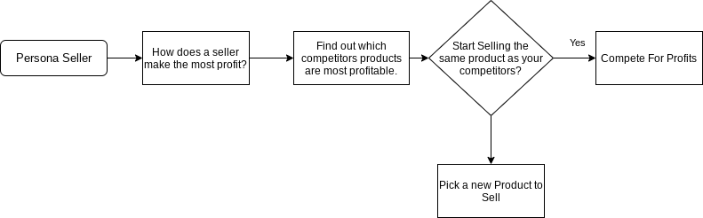
No

Slide 7

Persona Customer
James Cutter is trying to look for a birthday present for his teenage daughter. He is looking for an inexpensive item that has good reviews, and reliable sellers associated with it. He is 49 years old.

Slide 8
Journey Map Customer
Consider which inexpensive items have the best reviews
Look for inexpensive Items
Confirm that the sellers are reliable
Find the order_item_ID
Purchase the item

Slide 9
